Slide 1
Minimum Spanning Trees
Md Amjad Hossain
The original Slides are taken from Stanford: https://web.stanford.edu/class/archive/cs/cs161/cs161.1176/Slides/Lecture15.pdf

Slide 2

Minimum Spanning Tree
Say we have an undirected weighted graph
8
7
B
C
D
4
9
2
A tree is a
11
4
connected graph with no cycles!
A
I
14
E
7
6
8
10
1
2
H
G
F
A spanning tree is a tree that connects all of the vertices.

Slide 3
Minimum Spanning Tree
Say we have an undirected weighted graph
The cost of a
spanning tree is the sum of the weights on the
This is a spanning tree.
8
7
B C D
edges.
4
9
2
11
4
A
I
14
E
7
6
8
10
1
2
A tree is a
This tree has cost 67
connected graph with no cycles!
H
G
F
A spanning tree is a tree that connects all of the vertices.

Slide 4
Minimum Spanning Tree
Say we have an undirected weighted graph
8
7
This is also a spanning tree.
B
C
D
It has cost 37
4
9
2
11
4
A
I
14
E
7
6
8
10
1
2
A tree is a
H
G
F
connected graph with no cycles!
A spanning tree is a tree that connects all of the vertices.

Slide 5
Minimum Spanning Tree
Say we have an undirected weighted graph
8
7
B
C
D
4
9
2
11
4
A
I
14
E
7
6
8
10
1
2
H
G
F
minimum
of minimal cost
A spanning tree is a tree that connects all of the vertices.

Slide 6
Minimum Spanning Tree
Say we have an undirected weighted graph
8
7
This is a minimum spanning tree.
B
C
D
It has cost 37
4
9
2
11
4
A
I
14
E
7
6
8
10
1
2
H
G
F
minimum
of minimal cost
A spanning tree is a tree that connects all of the vertices.

Slide 7
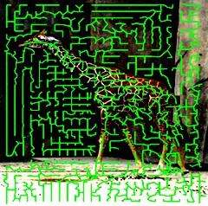
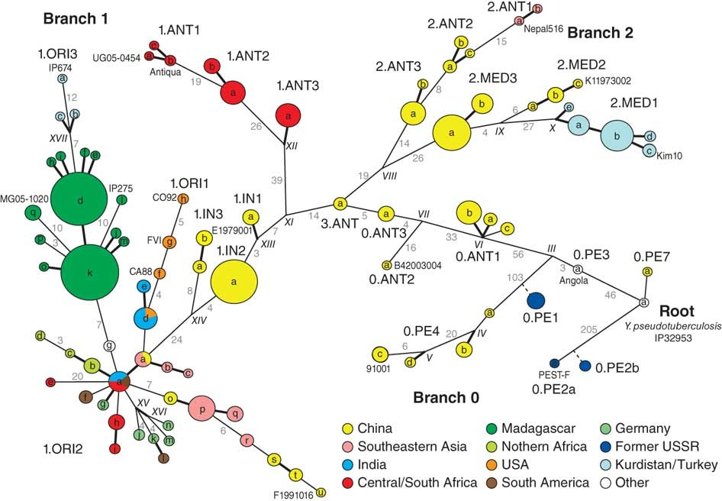
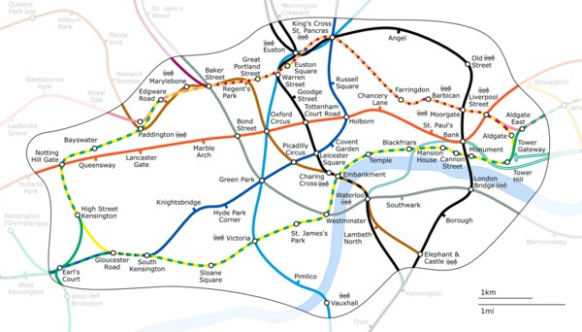
Why MSTs?
Network design
Connecting cities with roads/electricity/telephone/…
cluster analysis
eg, genetic distance
image processing
eg, image segmentation
Useful primitive
for other graph algs
Figure 2: Fully parsimonious minimal spanning tree of 933 SNPs for 282 isolates of Y. pestis colored by location.
Morelli et al. Nature genetics 2010

Slide 8
How to find an MST?
we’ll see two greedy algorithms.
In order to prove that these greedy algorithms work, we’ll need to show something like:
Suppose that our choices so far
haven’t ruled out success.
Then the next greedy choice that we make
also won’t rule out success.
Here, success means finding an MST.

Slide 9
Let’s brainstorm
How would we design a greedy algorithm?
8
7
B
C
D
4
9
2
11
4
A
I
14
E
7
6
8
10
1
2
H
G
F

Slide 10
Brief aside
for a discussion of cuts in graphs!

Slide 11

Cuts in graphs
A cut is a partition of the vertices into two parts:
8
7
B
C
D
4
9
2
11
4
A
I
14
E
7
6
8
10
1
2
H
G
F
This is the cut “{A,B,D,E} and {C,I,H,G,F}”

Slide 12
Let A be a set of edges in G
We say a cut respects A if no edges in A cross the cut.
An edge crossing a cut is called light if it has the smallest weight of any edge crossing the cut.
8
B
C
7
D
4
9
2
11
4
A
I
14
E
7
6
8
10
1
2
H
G
F
A is the thick orange edges

Slide 13
Let A be a set of edges in G
We say a cut respects A if no edges in A cross the cut.
An edge crossing a cut is called light if it has the smallest weight of any edge crossing the cut.
This edge is light
8
B C D
7
4
9
2
11
4
A
I
14
E
7
6
8
10
1
2
H
G
F
A is the thick orange edges

Slide 14
Lemma
Let A be a set of edges, and consider a cut that respects A.
Suppose there is an MST containing A.
Let (u,v) be a light edge.
Then there is an MST containing A ∪ {(u,v)}
We can safely add this edge to the tree
This is precisely the sort of statement we need for a greedy algorithm:
_{B} 8 _{C}
D
7
4
9
2
If we haven’t ruled out the possibility of success so far, then adding a light edge still won’t rule it out.
11
4
A
I
14
E
8
7
6
10
1
2
H
G F
A is the thick orange edges

Slide 15
Proof of Lemma
Assume that we have:
a cut that respects A
x
y
u
a
v
b

Slide 16






Proof of Lemma
Assume that we have:
a cut that respects A
A is part of some MST T.
Say that (u,v) is light.
lowest cost crossing the cut
x
y
u
a
v
b

Slide 17


Proof of Lemma
Claim: Adding any additional edge to a spanning tree will create a cycle.
Proof: Both endpoints are already in the tree and connected to each other.
Assume that we have:
a cut that respects A
A is part of some MST T.
Say that (u,v) is light.
lowest cost crossing the cut
But (u,v) is not in T.
So adding (u,v) to T
will make a cycle.
x
y
u
a
v
b

Slide 18

Proof of Lemma
Claim: Adding any additional edge to a spanning tree will create a cycle.
Proof: Both endpoints are already in the tree and connected to each other.
Assume that we have:
a cut that respects A
A is part of some MST T.
Say that (u,v) is light.
lowest cost crossing the cut
But (u,v) is not in T.
So adding (u,v) to T
will make a cycle.
So there is at least one other edge in this cycle crossing the cut.
call it (x,y)
x
y
u
a
v
b

Slide 19

Proof of Lemma ctd.
Consider swapping (u,v) for (x,y) in T.
Call the resulting tree T’.
x
y
u
a
v
b

Slide 20











Proof of Lemma ctd.
Consider swapping (u,v) for (x,y) in T.
Call the resulting tree T’.
Claim: T’ is still an MST.
It is still a tree:
we deleted (x,y)
x
y
It has cost at most that of T
because (u,v) was light.
T had minimal cost.
So T’ does too.
u
a
So T’ is an MST containing (u,v).
This is what we wanted.
v
b

Slide 21

Lemma
Let A be a set of edges, and consider a cut that respects A.
Suppose there is an MST containing A.
Let (u,v) be a light edge.
Then there is an MST containing A ∪ {(u,v)}
This edge is light
_{B} 8 _{C}
D
7
4
9
2
11
4
A
I
14
E
8
7
1
6
G F
10
2
H
A is the thick orange edges

Slide 22
End aside
Back to MSTs!

Slide 23
Back to MSTs
How do we find one?
we’ll see two greedy algorithms.
The strategy:
Make a series of choices, adding edges to the tree.
Show that each edge we add is safe to add:
we do not rule out the possibility of success
we will choose light edges crossing cuts and use the Lemma.
Keep going until we have an MST.

Slide 24

Idea 1
Start growing a tree, greedily add the shortest edge we can to grow the tree.
8
7
B
C
D
4
9
2
11
4
A
I
14
E
7
6
8
10
1
2
H
G
F

Slide 25
Idea 1
Start growing a tree, greedily add the shortest edge we can to grow the tree.
8
7
B
C
D
4
9
2
11
4
A
I
14
E
7
6
8
10
1
2
H
G
F

Slide 26
Idea 1
Start growing a tree, greedily add the shortest edge we can to grow the tree.
8
7
B
C
D
4
9
2
11
4
A
I
14
E
7
6
8
10
1
2
H
G
F

Slide 27
Idea 1
Start growing a tree, greedily add the shortest edge we can to grow the tree.
8
7
B
C
D
4
9
2
11
4
A
I
14
E
7
6
8
10
1
2
H
G
F

Slide 28
Idea 1
Start growing a tree, greedily add the shortest edge we can to grow the tree.
8
7
B
C
D
4
9
2
11
4
A
I
14
E
7
6
8
10
1
2
H
G
F

Slide 29
Idea 1
Start growing a tree, greedily add the shortest edge we can to grow the tree.
8
7
B
C
D
4
9
2
11
4
A
I
14
E
7
6
8
10
1
2
H
G
F

Slide 30
Idea 1
Start growing a tree, greedily add the shortest edge we can to grow the tree.
8
7
B
C
D
4
9
2
11
4
A
I
14
E
7
6
8
10
1
2
H
G
F

Slide 31
Idea 1
Start growing a tree, greedily add the shortest edge we can to grow the tree.
8
7
B
C
D
4
9
2
11
4
A
I
14
E
7
6
8
10
1
2
H
G
F

Slide 32
Idea 1
Start growing a tree, greedily add the shortest edge we can to grow the tree.
8
7
B
C
D
4
9
2
11
4
A
I
14
E
7
6
8
10
1
2
H
G
F

Slide 33
We’ve discovered Prim’s algorithm!
slowPrim( G = (V,E), starting vertex s ):
Let (s,u) be the lightest edge coming out of s.
MST = { (s,u) }
verticesVisited = { s, u }
while |verticesVisited| < |V|:
find the lightest edge (x,v) in E so that:
x is in verticesVisited
v is not in verticesVisited
add (x,v) to MST
add v to verticesVisited
n iterations of this while loop.
Maybe take time m to go through all the edges and find the lightest.
return MST
Naively, the running time is O(nm): n = |V|, m =|E|
For each of n-1 iterations of the while loop:
Maybe go through all the edges.

Slide 34
Two questions
Does it work?
That is, does it actually return a MST?
How do we actually implement this?
the pseudocode above says “slowPrim”…

Slide 35
Does it work?
We need to show that our greedy choices don’t rule out success.
That is, at every step:
There exists an MST that contains all of the edges we have added so far.
Now it is time to use our lemma!

Slide 36
Lemma
Let A be a set of edges, and consider a cut that respects A.
Suppose there is an MST containing A.
Let (u,v) be a light edge.
Then there is an MST containing A ∪ {(u,v)}
This edge is light
_{B} 8 _{C}
D
7
4
9
2
11
4
A
I
14
E
8
7
1
6
G F
10
2
H
A is the thick orange edges

Slide 37
Suppose we are partway through Prim
Assume that our choices A so far are safe.
they don’t rule out success
Consider the cut {visited, unvisited}
A respects this cut.
A is the set of
edges selected so far.
8
7 _{D}
B
C
4
9
11
2
4
A
I
14
E
7
H ₁
6
G
8
2
10
F

Slide 38
Suppose we are partway through Prim
Assume that our choices A so far are safe.
they don’t rule out success
Consider the cut {visited, unvisited}
A respects this cut.
The edge we add next is a light edge.
Least weight of any edge crossing the cut.
By the Lemma,
A is the set of
edges selected so far.
this edge is safe.
it also doesn’t rule out
8
7 _{D}
B C
4
9
11
2
4
success.
A
I
14
E
7
H ₁
6
G
8
2
10
add this one next
F

Slide 39
Hooray!
Our greedy choices don’t rule out success.
This is enough (along with an argument by induction) to guarantee correctness of Prim’s algorithm.

Slide 40
This is what we needed
Inductive hypothesis:
After adding the t’th edge, there exists an MST with the edges added so far.
Base case:
After adding the 0’th edge, there exists an MST with the edges added so far. YEP.
Inductive step:
If the inductive hypothesis holds for t (aka, the choices so far are safe), then it holds for t+1 (aka, the next edge we add is safe).
That’s what we just showed.
Conclusion:
After adding the n-1’st edge, there exists an MST with the edges added so far.
At this point we have a spanning tree, so it better be minimal.

Slide 41
Two questions
Does it work?
That is, does it actually return a MST?
Yes!
How do we actually implement this?
the pseudocode above says “slowPrim”…

Slide 42

How do we actually implement this?
Each vertex keeps:
the distance from itself to the growing spanning tree
how to get there.
if you can get there in one edge.
I’m 7 away.
C is the closest.
8
7
B
C
D
4
9
2
11
4
A
I
14
E
7 6
_{H} 1 _{G} 2
8
10
I can’t get to the tree in one edge
F

Slide 43
How do we actually implement this?
Each vertex keeps:
the distance from itself to the growing spanning tree
how to get there.
Choose the closest vertex, add it.
if you can get there in one edge.
I’m 7 away.
C is the closest.
8
7
B
C
D
4
9
2
11
4
A
I
14
E
7 6
_{H} 1 _{G} 2
8
10
I can’t get to the tree in one edge
F

Slide 44
How do we actually implement this?
Each vertex keeps:
the distance from itself to the growing spanning tree
how to get there.
Choose the closest vertex, add it.
if you can get there in one edge.
I’m 7 away.
C is the closest.
8
7
B
C
D
4
9
2
11
4
A
I
14
E
7 6
_{H} 1 _{G} 2
8
10
I can’t get to the tree in one edge
F

Slide 45
How do we actually implement this?
Each vertex keeps:
the distance from itself to the growing spanning tree
how to get there.
Choose the closest vertex, add it.
Update the stored info.
if you can get there in one edge.
I’m 7 away.
C is the closest.
8 7
B
C
D
4
9
2
11
4
A
I
14
E
7 6
_{H} 1 _{G} 2
8
10
I’m 10 away.
F is the closest.
F

Slide 46

Efficient implementation
x Can’t reach x yet x x is “active”
_{x} Can reach x
Every vertex has a key and a parent
Until all the vertices are reached:
k[x]
k[x] is the distance of x from the growing tree
p[b] = a, meaning that a was the vertex that k[b] comes from.
a b
∞
∞
∞
D
8
7
B
C
4
9
2
11
4
∞
A
I
∞
14
E
0
7
6
8
10
1
2
H
G
F
∞
∞
∞

Slide 47

Efficient implementation
x Can’t reach x yet x x is “active”
_{x} Can reach x
Every vertex has a key and a parent
Until all the vertices are reached:
Activate the unreached vertex u with the smallest key.
k[x]
k[x] is the distance of x from the growing tree
p[b] = a, meaning that a was the vertex that k[b] comes from.
a b
∞
∞
∞
D
8
7
B
C
4
9
2
11
4
∞
A
I
∞
14
E
0
7
6
8
10
1
2
H
G
F
∞
∞
∞

Slide 48
Efficient implementation
x Can’t reach x yet x x is “active”
_{x} Can reach x
Every vertex has a key and a parent
Until all the vertices are reached:
Activate the unreached vertex u with the smallest key.
for each of u’s neighbors v:
k[v] = min( k[v], weight(u,v) )
if k[v] updated, p[v] = u
k[x]
k[x] is the distance of x from the growing tree
p[b] = a, meaning that a was the vertex that k[b] comes from.
a b
4
∞
∞
D
8
7
B
C
4
9
2
11
4
∞
A
I
∞
14
E
0
7
6
8
10
1
2
H
G
F
∞
8
∞

Slide 49
Efficient implementation
x Can’t reach x yet x x is “active”
_{x} Can reach x
Every vertex has a key and a parent
Until all the vertices are reached:
Activate the unreached vertex u with the smallest key.
for each of u’s neighbors v:
k[v] = min( k[v], weight(u,v) )
if k[v] updated, p[v] = u
Mark u as reached, and add (p[u],u) to MST.
k[x] is the distance of x from the growing tree
p[b] = a, meaning that a was the vertex that k[b] comes from.
k[x]
a b
4
∞
∞
D
8 7
B
C
4
9
2
11
4
∞
A
I
∞
14
E
0
7
6
8
10
1
2
H
G
F
∞
8
∞

Slide 50

Efficient implementation
x Can’t reach x yet x x is “active”
_{x} Can reach x
Every vertex has a key and a parent
Until all the vertices are reached:
Activate the unreached vertex u with the smallest key.
for each of u’s neighbors v:
k[v] = min( k[v], weight(u,v) )
if k[v] updated, p[v] = u
Mark u as reached, and add (p[u],u) to MST.
k[x] is the distance of x from the growing tree
p[b] = a, meaning that a was the vertex that k[b] comes from.
k[x]
a b
4
∞
∞
D
8 7
B
C
4
9
2
11
4
∞
A
I
∞
14
E
0
7
6
8
10
1
2
H
G
F
∞
8
∞

Slide 51
Efficient implementation
x Can’t reach x yet x x is “active”
_{x} Can reach x
Every vertex has a key and a parent
Until all the vertices are reached:
Activate the unreached vertex u with the smallest key.
for each of u’s neighbors v:
k[v] = min( k[v], weight(u,v) )
if k[v] updated, p[v] = u
Mark u as reached, and add (p[u],u) to MST.
k[x] is the distance of x from the growing tree
p[b] = a, meaning that a was the vertex that k[b] comes from.
k[x]
a b
4
8
∞
D
8 7
B
C
4
9
2
11
4
∞
A
I
∞
14
E
0
7
6
8
10
1
2
H
G
F
∞
8
∞

Slide 52
Efficient implementation
x Can’t reach x yet x x is “active”
_{x} Can reach x
Every vertex has a key and a parent
Until all the vertices are reached:
Activate the unreached vertex u with the smallest key.
for each of u’s neighbors v:
k[v] = min( k[v], weight(u,v) )
if k[v] updated, p[v] = u
Mark u as reached, and add (p[u],u) to MST.
k[x] is the distance of x from the growing tree
p[b] = a, meaning that a was the vertex that k[b] comes from.
k[x]
a b
4
8
∞
D
8 7
B
C
4
9
2
11
4
∞
A
I
∞
14
E
0
7
6
8
10
1
2
H
G
F
∞
8
∞

Slide 53

Efficient implementation
x Can’t reach x yet x x is “active”
_{x} Can reach x
Every vertex has a key and a parent
Until all the vertices are reached:
Activate the unreached vertex u with the smallest key.
for each of u’s neighbors v:
k[v] = min( k[v], weight(u,v) )
if k[v] updated, p[v] = u
Mark u as reached, and add (p[u],u) to MST.
k[x] is the distance of x from the growing tree
p[b] = a, meaning that a was the vertex that k[b] comes from.
k[x]
a b
4
8
∞
D
8 7
B
C
4
9
2
11
4
∞
A
I
∞
14
E
0
7
6
8
10
1
2
H
G
F
∞
8
∞

Slide 54
Efficient implementation
x Can’t reach x yet x x is “active”
_{x} Can reach x
Every vertex has a key and a parent
Until all the vertices are reached:
Activate the unreached vertex u with the smallest key.
for each of u’s neighbors v:
k[v] = min( k[v], weight(u,v) )
if k[v] updated, p[v] = u
Mark u as reached, and add (p[u],u) to MST.
k[x] is the distance of x from the growing tree
p[b] = a, meaning that a was the vertex that k[b] comes from.
k[x]
a b
4
8
7
8 7
B
C
D
4
9
2
11
4
∞
A
I
2
14
E
0
7
6
8
10
1
2
H
G
F
4
8
∞

Slide 55
Efficient implementation
x Can’t reach x yet x x is “active”
_{x} Can reach x
Every vertex has a key and a parent
Until all the vertices are reached:
Activate the unreached vertex u with the smallest key.
for each of u’s neighbors v:
k[v] = min( k[v], weight(u,v) )
if k[v] updated, p[v] = u
Mark u as reached, and add (p[u],u) to MST.
k[x] is the distance of x from the growing tree
p[b] = a, meaning that a was the vertex that k[b] comes from.
k[x]
a b
4
8
7
8 7
B
C
D
4
9
2
11
4
∞
A
I
2
14
E
0
7
6
8
10
1
2
H
G
F
4
8
∞

Slide 56

Efficient implementation
x Can’t reach x yet x x is “active”
_{x} Can reach x
Every vertex has a key and a parent
Until all the vertices are reached:
Activate the unreached vertex u with the smallest key.
for each of u’s neighbors v:
k[v] = min( k[v], weight(u,v) )
if k[v] updated, p[v] = u
Mark u as reached, and add (p[u],u) to MST.
k[x] is the distance of x from the growing tree
p[b] = a, meaning that a was the vertex that k[b] comes from.
k[x]
a b
4
8
7
8 7
B
C
D
4
9
2
11
4
∞
A
I
2
14
E
0
7
6
8
10
1
2
H
G
F
4
8
∞

Slide 57
Efficient implementation
x Can’t reach x yet x x is “active”
_{x} Can reach x
Every vertex has a key and a parent
Until all the vertices are reached:
Activate the unreached vertex u with the smallest key.
for each of u’s neighbors v:
k[v] = min( k[v], weight(u,v) )
if k[v] updated, p[v] = u
Mark u as reached, and add (p[u],u) to MST.
k[x] is the distance of x from the growing tree
p[b] = a, meaning that a was the vertex that k[b] comes from.
k[x]
a b
4
8
7
8 7
B
C
D
4
9
2
11
4
∞
A
I
14
E
2
0
7
6
8
10
1
2
H
G
F
4
7
6

Slide 58
Efficient implementation
x Can’t reach x yet x x is “active”
_{x} Can reach x
Every vertex has a key and a parent
Until all the vertices are reached:
Activate the unreached vertex u with the smallest key.
for each of u’s neighbors v:
k[v] = min( k[v], weight(u,v) )
if k[v] updated, p[v] = u
Mark u as reached, and add (p[u],u) to MST.
k[x] is the distance of x from the growing tree
p[b] = a, meaning that a was the vertex that k[b] comes from.
k[x]
a b
4
8
7
8 7
B
C
D
4
9
2
11
4
∞
A
I
14
E
2
0
7
6
8
10
1
2
H
G
F
4
7
6

Slide 59

Efficient implementation
x Can’t reach x yet x x is “active”
_{x} Can reach x
Every vertex has a key and a parent
Until all the vertices are reached:
Activate the unreached vertex u with the smallest key.
for each of u’s neighbors v:
k[v] = min( k[v], weight(u,v) )
if k[v] updated, p[v] = u
Mark u as reached, and add (p[u],u) to MST.
k[x] is the distance of x from the growing tree
p[b] = a, meaning that a was the vertex that k[b] comes from.
k[x]
a b
4
8
7
8 7
B
C
D
4
9
2
11
4
∞
A
I
14
E
2
0
7
6
8
10
1
2
H
G
F
4
7
6

Slide 60
Efficient implementation
x Can’t reach x yet x x is “active”
_{x} Can reach x
Every vertex has a key and a parent
Until all the vertices are reached:
Activate the unreached vertex u with the smallest key.
for each of u’s neighbors v:
k[v] = min( k[v], weight(u,v) )
if k[v] updated, p[v] = u
Mark u as reached, and add (p[u],u) to MST.
k[x] is the distance of x from the growing tree
p[b] = a, meaning that a was the vertex that k[b] comes from.
k[x]
a b
4
8
7
8 7
B
C
D
4
9
2
11
4
10
A
I
2
14
E
0
7
6
8
10
1
2
H
G
F
4
7
2

Slide 61
Efficient implementation
x Can’t reach x yet x x is “active”
_{x} Can reach x
Every vertex has a key and a parent
Until all the vertices are reached:
Activate the unreached vertex u with the smallest key.
for each of u’s neighbors v:
k[v] = min( k[v], weight(u,v) )
if k[v] updated, p[v] = u
Mark u as reached, and add (p[u],u) to MST.
k[x] is the distance of x from the growing tree
p[b] = a, meaning that a was the vertex that k[b] comes from.
k[x]
a b
4
8
7
8 7
B
C
D
4
9
2
11
4
10
A
I
2
14
E
0
7
6
8
10
1
2
H
G
F
4
7
2

Slide 62
Efficient implementation
x Can’t reach x yet x x is “active”
_{x} Can reach x
Every vertex has a key and a parent
Until all the vertices are reached:
Activate the unreached vertex u with the smallest key.
for each of u’s neighbors v:
k[v] = min( k[v], weight(u,v) )
if k[v] updated, p[v] = u
Mark u as reached, and add (p[u],u) to MST.
k[x] is the distance of x from the growing tree
p[b] = a, meaning that a was the vertex that k[b] comes from.
k[x]
a b
4
8
7
8 7
B
C
D
4
9
2
11
4
10
A
I
2
14
E
0
7
6
8
e¹tc.^{G}
10
2
H
F
4
7
2

Slide 63
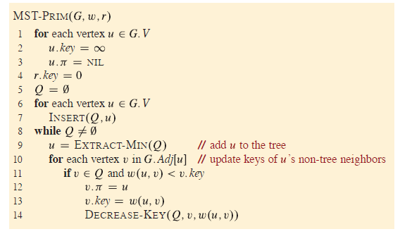
Running time
Full Algorithm
Exactly the same as Dijkstra:
O(mlog(n)) using a Red-Black tree as a priority queue.
O(m + nlog(n)) if we use a Fibonacci Heap*.
*See CS166

Slide 64
What have we learned?
Prim’s algorithm greedily grows a tree
smells a lot like Dijkstra’s algorithm
It finds a Minimum Spanning Tree in time O(mlog(n))
if we implement it with a Red-Black Tree
To prove it worked, we followed the same recipe for greedy algorithms we saw last time.
Show that, at every step, we don’t rule out success.

Slide 65
That’s not the only greedy algorithm
what if we just always take the cheapest edge? whether or not it’s connected to what we have so far?
8
7
B
C
D
4
9
2
11
4
A
I
14
E
7
6
8
10
1
2
H
G
F

Slide 66
That’s not the only greedy algorithm
what if we just always take the cheapest edge? whether or not it’s connected to what we have so far?
8
7
B
C
D
4
9
2
11
4
A
I
14
E
7
6
8
10
1
2
H
G
F

Slide 67
That’s not the only greedy algorithm
what if we just always take the cheapest edge? whether or not it’s connected to what we have so far?
8
7
B
C
D
4
9
2
11
4
A
I
14
E
7
6
8
10
1
2
H
G
F

Slide 68
That’s not the only greedy algorithm
what if we just always take the cheapest edge? whether or not it’s connected to what we have so far?
8
7
B
C
D
4
9
2
11
4
A
I
14
E
7
6
8
10
1
2
H
G
F

Slide 69
That’s not the only greedy algorithm
what if we just always take the cheapest edge? whether or not it’s connected to what we have so far?
8
7
B
C
D
4
9
2
11
4
A
I
14
E
7
6
8
10
1
2
H
G
F

Slide 70
That’s not the only greedy algorithm
what if we just always take the cheapest edge? whether or not it’s connected to what we have so far?
8
7
B
C
D
4
9
2
11
4
A
I
14
E
7
6
8
10
1
2
H
G
F

Slide 71
That’s not the only greedy algorithm
what if we just always take the cheapest edge? whether or not it’s connected to what we have so far?
That won’t cause a cycle
8
7
B C D
4
9
2
11
4
A
I
14
E
7
6
8
10
1
2
H
G
F

Slide 72
That’s not the only greedy algorithm
what if we just always take the cheapest edge? whether or not it’s connected to what we have so far?
That won’t cause a cycle
8
7
B C D
4
9
2
11
4
A
I
14
E
7
6
8
10
1
2
H
G
F

Slide 73
That’s not the only greedy algorithm
what if we just always take the cheapest edge? whether or not it’s connected to what we have so far?
That won’t cause a cycle
8
7
B C D
4
9
2
11
4
A
I
14
E
7
6
8
10
1
2
H
G
F

Slide 74
That’s not the only greedy algorithm
what if we just always take the cheapest edge? whether or not it’s connected to what we have so far?
That won’t cause a cycle
8
7
B C D
4
9
2
11
4
A
I
14
E
7
6
8
10
1
2
H
G
F

Slide 75
That’s not the only greedy algorithm
what if we just always take the cheapest edge? whether or not it’s connected to what we have so far?
That won’t cause a cycle
8
7
B C D
4
9
2
11
4
A
I
14
E
7
6
8
10
1
2
H
G
F

Slide 76
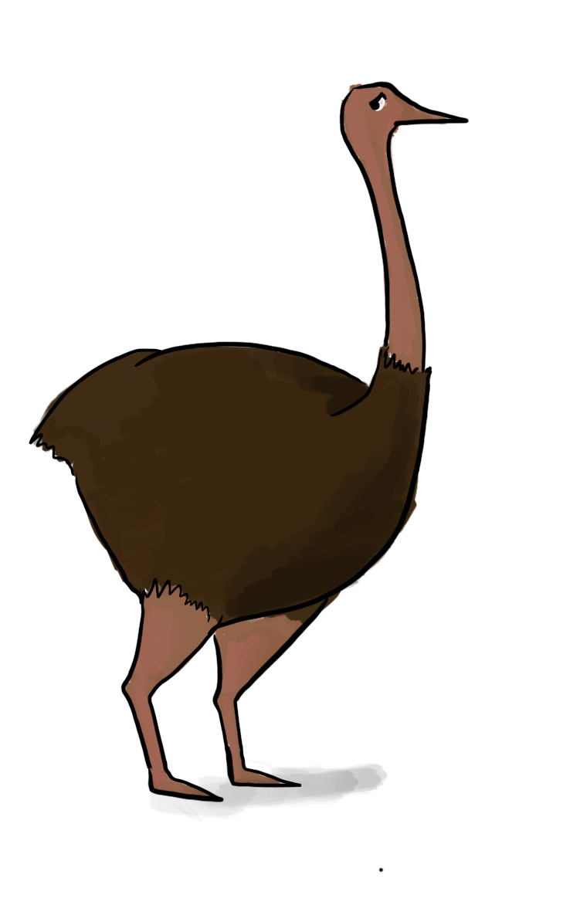
We’ve discovered Kruskal’s algorithm!
slowKruskal(G = (V,E)):
Sort the edges in E by non-decreasing weight.
MST = {}
for e in E (in sorted order):
m iterations through this loop
if adding e to MST won’t cause a cycle:
add e to MST.
return MST
How do we check this?
How would you figure out if added e would make a cycle in this algorithm?
Naively, the running time is ???:
For each of m iterations of the for loop:
Check if adding e would cause a cycle…

Slide 77
Two questions
Does it work?
That is, does it actually return a MST?
How do we actually implement this?
the pseudocode above says “slowKruskal”…
Let’s do this one first

Slide 78

At each step of Kruskal’s, we are maintaining a forest.
A forest is a collection of disjoint trees
8
7
B
C
D
4
9
2
11
4
A
I
14
E
7
6
8
10
1
2
H
G
F

Slide 79






At each step of Kruskal’s, we are maintaining a forest.
A forest is a collection of disjoint trees
8
7
B
C
D
4
9
2
11
4
A
I
14
E
7
6
8
10
1
2
H
G
F

Slide 80
At each step of Kruskal’s, we are maintaining a forest.
A forest is a collection of disjoint trees
When we add an edge, we merge two trees:
8
7
B
C
D
4
9
2
11
4
A
I
14
E
7
6
8
10
1
2
H
G
F

Slide 81
At each step of Kruskal’s, we are maintaining a forest.
A forest is a collection of disjoint trees
When we add an edge, we merge two trees:
8
7
B
C
D
4
9
2
11
4
A
I
14
E
7
6
8
10
1
2
H
G
F

Slide 82
At each step of Kruskal’s, we are maintaining a forest.
A forest is a collection of disjoint trees
When we add an edge, we merge two trees:
8
7
B
C
D
4
9
2
11
4
A
I
14
E
7
6
8
10
1
2
H
G
F
We never add an edge within a tree since that would create a cycle.

Slide 83
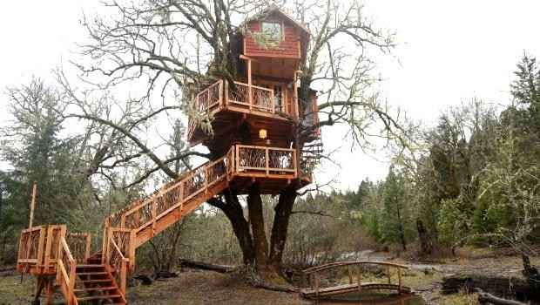
Keep the trees in a special data structure
“treehouse”?

Slide 84
Union-find data structure
also called disjoint-set data structure
Used for storing collections of sets
Supports:
makeSet(u): create a set {u}
find(u): return the set that u is in
union(u,v): merge the set that u is in with the set that v is in.
makeSet(x) makeSet(y) makeSet(z)
x
y
union(x,y)
z

Slide 85
Union-find data structure
also called disjoint-set data structure
Used for storing collections of sets
Supports:
makeSet(u): create a set {u}
find(u): return the set that u is in
union(u,v): merge the set that u is in with the set that v is in.
makeSet(x) makeSet(y) makeSet(z)
x
y
union(x,y)
z

Slide 86
Union-find data structure
also called disjoint-set data structure
Used for storing collections of sets
Supports:
makeSet(u): create a set {u}
find(u): return the set that u is in
union(u,v): merge the set that u is in with the set that v is in.
makeSet(x) makeSet(y) makeSet(z)
x
y
union(x,y)
z
find(x)

Slide 87
Kruskal pseudo-code
kruskal(G = (V,E)):
Sort E by weight in non-decreasing order
MST = {}
for v in V:
makeSet(v)
for (u,v) in E:
if find(u) != find(v):
add (u,v) to MST
union(u,v)
return MST
// initialize an empty tree
// put each vertex in its own tree in the forest
// go through the edges in sorted order
// if u and v are not in the same tree
// merge u’s tree with v’s tree

Slide 88
Once more…
To start, every vertex is in it’s own tree.
8
7
B
C
D
4
9
2
11
4
A
I
14
E
7
6
8
10
1
2
H
G
F

Slide 89
Once more…
Then start merging.
8
7
B
C
D
4
9
2
11
4
A
I
14
E
7
6
8
10
1
2
H
G
F

Slide 90
Once more…
Then start merging.
8
7
B
C
D
4
9
2
11
4
A
I
14
E
7
6
8
10
1
2
H
G
F

Slide 91
Once more…
Then start merging.
8
7
B
C
D
4
9
2
11
4
A
I
14
E
7
6
8
10
1
2
H
G
F

Slide 92
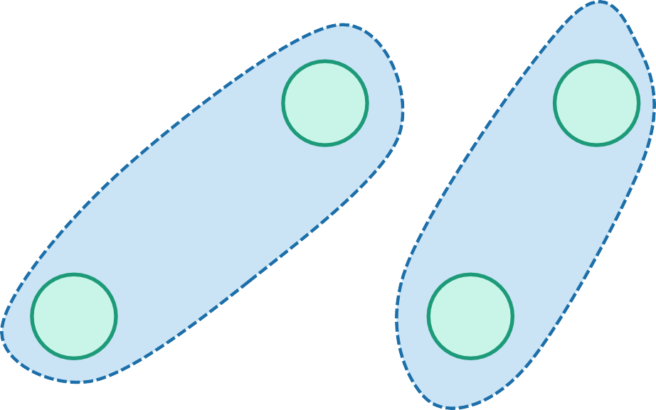
Once more…
Then start merging.
8
7
B
C
D
4
9
2
11
4
A
I
14
E
7
6
8
10
1
2
H
G
F

Slide 93
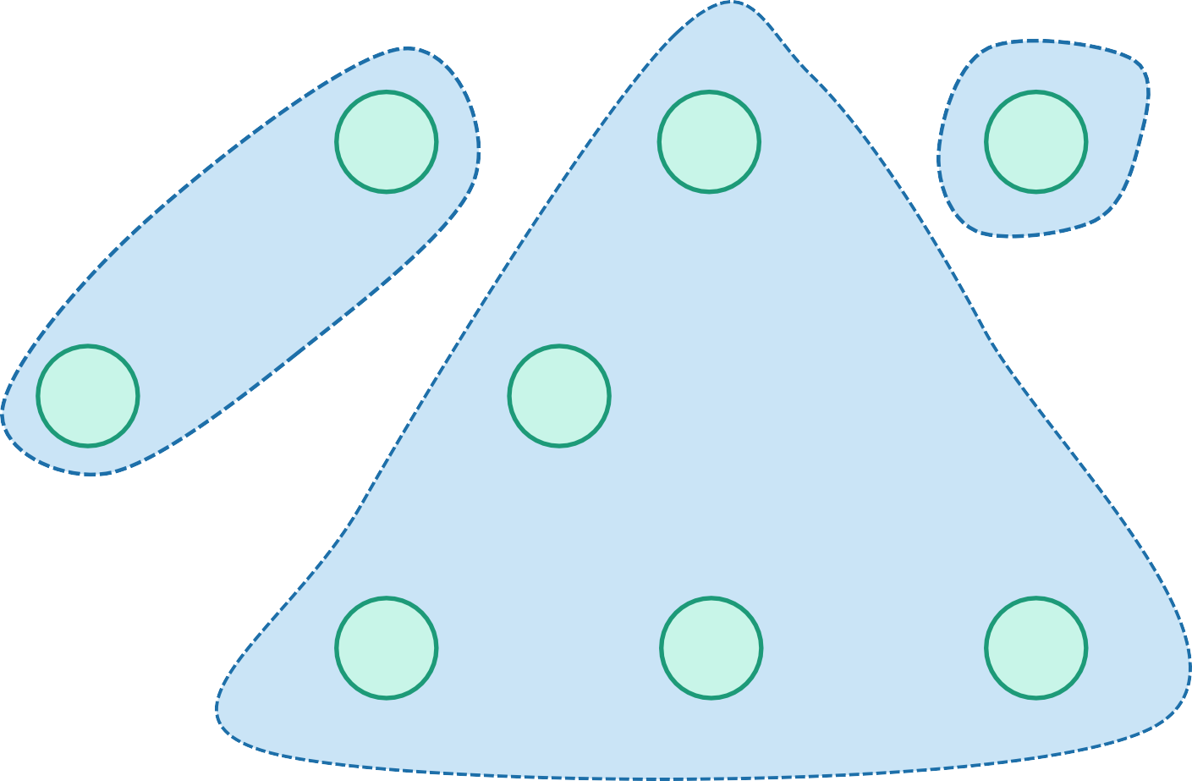
Once more…
Then start merging.
8
7
B
C
D
4
9
2
11
4
A
I
14
E
7
6
8
10
1
2
H
G
F

Slide 94
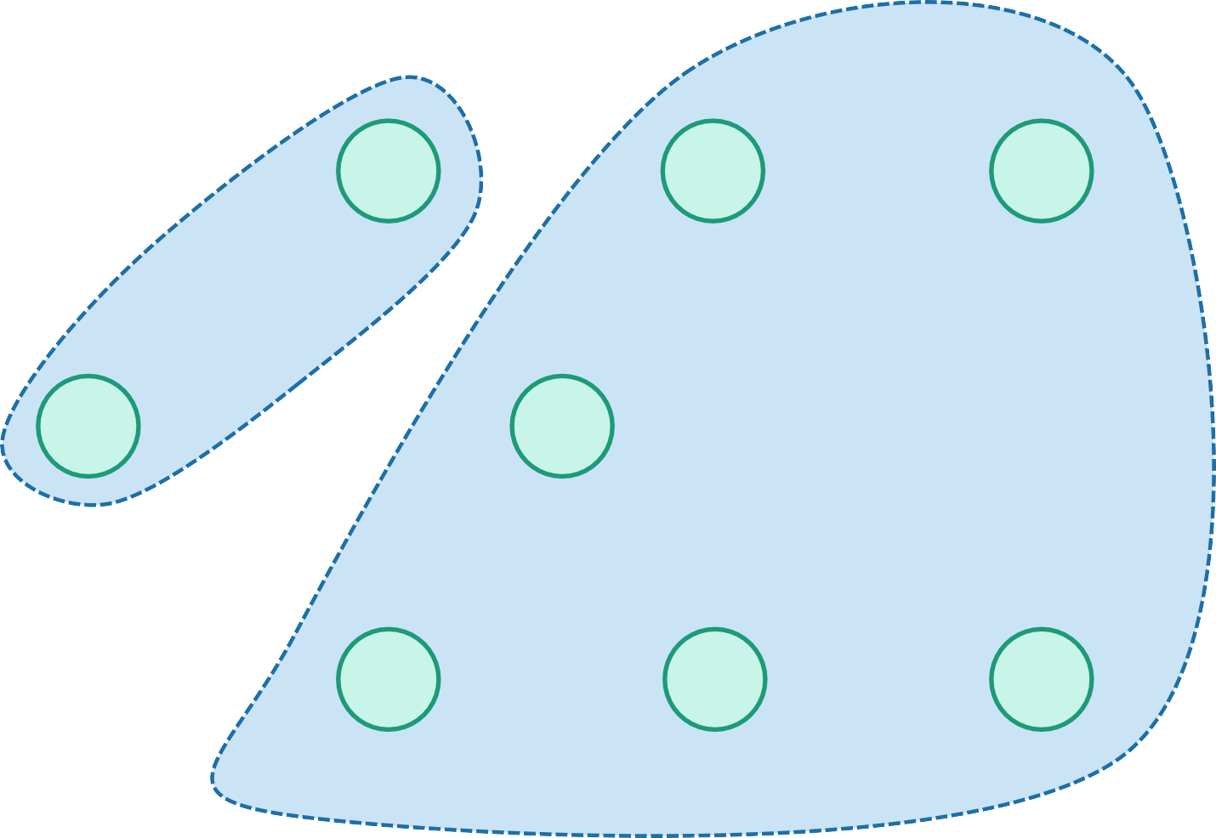
Once more…
Then start merging.
8
7
B
C
D
4
9
2
11
4
A
I
14
E
7
6
8
10
1
2
H
G
F

Slide 95
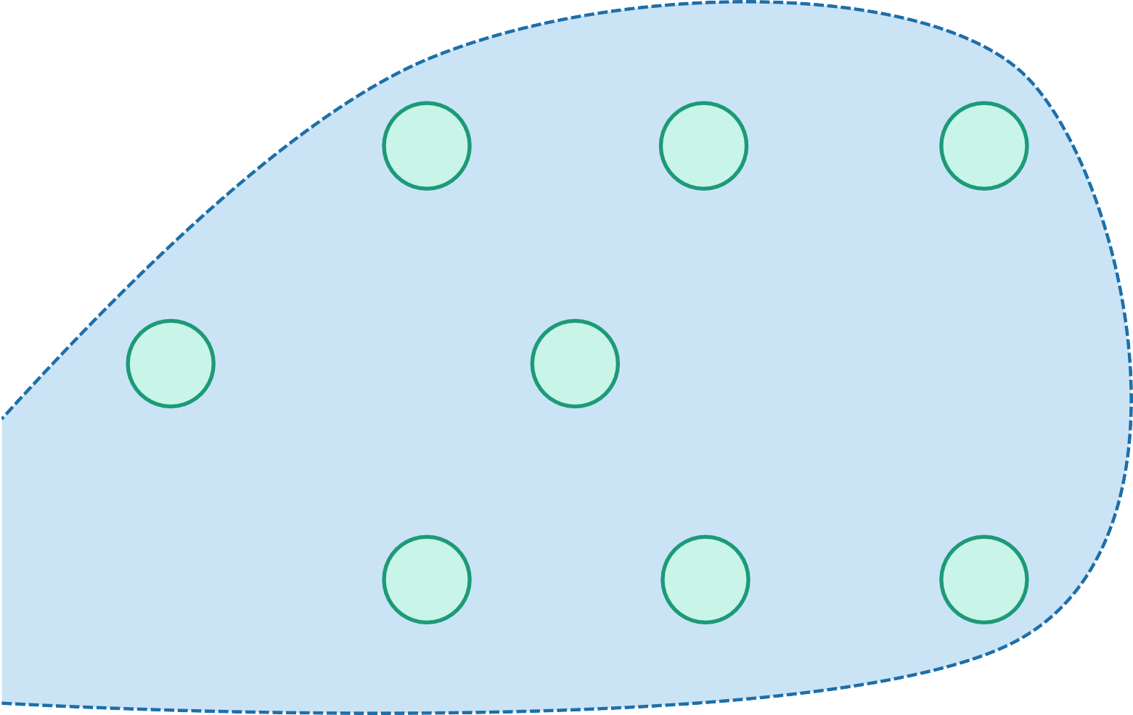
Once more…
Then start merging.
8
7
B
C
D
4
9
2
11
4
A
I
14
E
7
6
8
10
1
2
H
G
F

Slide 96
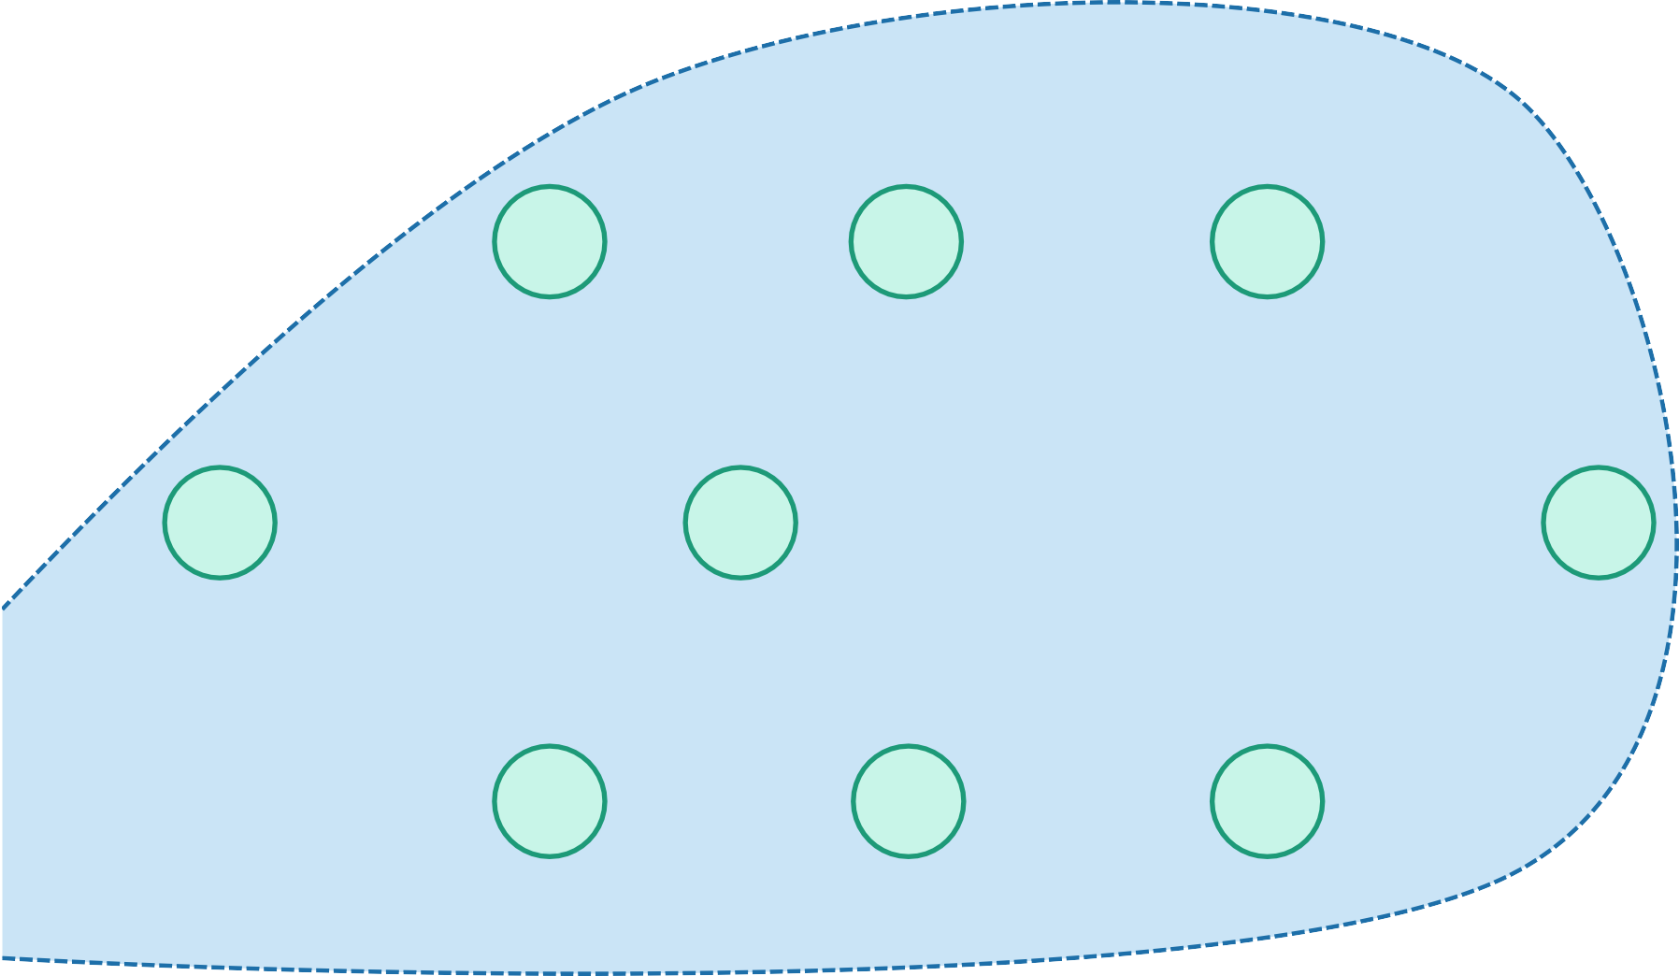
Stop when we have one big tree!
Once more…
Then start merging.
8
7
B
C
D
4
9
2
11
4
A
I
14
E
7
6
8
10
1
2
H
G
F

Slide 97
Running time
Sorting the edges takes O(m log(m))
In practice, if the weights are integers we can use radixSort and take time O(m)
For the rest:
In practice, each of makeSet, find, and union run in constant time*
n calls to makeSet
put each vertex in its own set
2m calls to find
for each edge, find its endpoints
kruskal(G = (V,E)):
Sort E by weight in non-decreasing order
n calls to union
we will never add more than n-1 edges to the tree,
so we will never call union more than n-1 times.
Total running time:
Worst-case O(mlog(n)), just like Prim.
Closer to O(m) if you can do radixSort
*technically, they run in amortized time O(𝛼(𝑛)), where 𝛼(𝑛) is the inverse Ackerman function.
𝛼 𝑛 ≤ 4 provided that n is smaller than the number of atoms in the universe.
MST = {}
for v in V:
makeSet(v)
for (u,v) in E:
if find(u) != find(v):
add (u,v) to MST
union(u,v)
return MST

Slide 98


Compare and contrast
Prim:
Grows a tree.
Time O(mlog(n)) with a red-black tree
Time O(m + nlog(n)) with a Fibonacci heap
Kruskal:
Grows a forest.
Time O(mlog(n)) with a union-find data structure
If you can do radixSort on the edge weights, morally O(m)

Slide 99
Recap
Two algorithms for Minimum Spanning Tree
Prim’s algorithm
Kruskal’s algorithm
Both are (more) examples of greedy algorithms!
Make a series of choices.
Show that at each step, your choice does not rule out success.
At the end of the day, you haven’t ruled out success, so
you must be successful.

